Slide 1
Concentrix Voicebot –
Digital CX Agent

Slide 2
“We automate customer interactions – help improve service outcomes and customer engagement while reducing the cost to serve.”
Cost Effectiveness
Manoeuvrability
Scalability
65-90%
Reduction in cost per call
25-35%
Of calls successfully resolved by VoiceBOT (on par with live Agents)
4-5X
Scaling to handle backlog and seasonal demands
*Data based on real case study
Not all customer contacts are a priority, nor do all requests require human intervention. Smart Contact management is to enable customer experience in most efficient manner through Automation and Omni Channel experience.

Slide 3
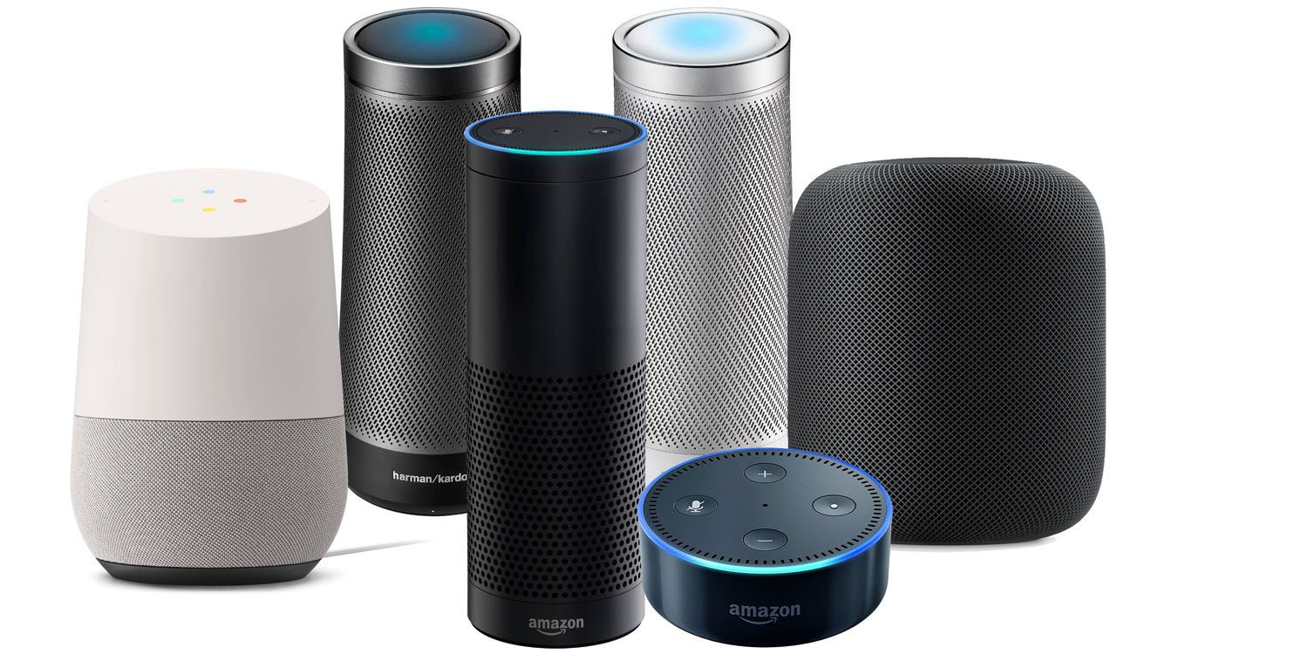






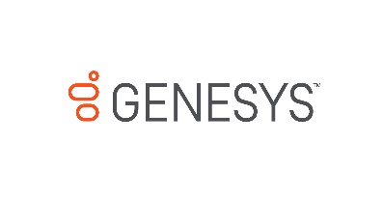














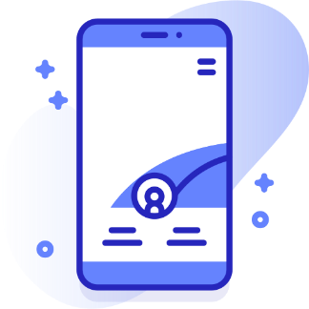

AI Powered CX
Intelligent Agent Assist –
Steering call process systematically.
CNX
Voice Assistant
Human Bot Collaboration –
Automate Mundane repetitive Task
Smart Channels
Smart Self-Serve
Knowledge bot –
Quick Access to information
Speech Recognition
Email bot –
Swiftly Respond to Email Using AI
Natural language
Contact Deflection
After Call Work –
Compliant and Automated Notes
CNX
Virtual Assistant
Inbound/Outbound
Voice Call
Machine learning
Tech Infused Agent Operation
Smart Agent
Contact Center Platform
Concentrix AI
Framework
ALBA –
AI driven Advisor Training
Contact Optimization

Slide 4

Concentrix UX Framework - Outcomes
Platform | Voicebot | ChatBot | Intelligent Assist | Human Agent Collaboration | EmailBot | Knowledge Bot | After Call Work
Improve CSAT
Improve NPS
Improve ROI
Improve FCR
Improve Compliance
Reduce AHT
Reduce FTE

Slide 5
Concentrix Voicebot – Simplifies Customer Experience (CX)
Flattened tree with dynamic menus & context across Omni channels for inbound and outbound –
Speak what you need Naturally.
IN-CALL
Understands context and intelligently routes to Self-serving digital agent or ropes in human agent –
Speak to Right agent with Context.
John Doe
End to End call handling by VoiceBOT for processes like collections, welcome, reminder, scheduling etc.–
Along with Full service DIGITAL AGENT .
Learn from human interactions and create a engaging experiences and generate incremental value with time – Continuous Seamless Learning.

Slide 6



Concentrix Automation Journey
To enhance Automation penetration & increase Efficiency
With Low Complexity use case, Test Client Environment and IT dynamics with POC and build transformation glidepath accordingly
Automation at scale, start with Pilot and scale as per demand
Leverage common resources to reduce cost burden on one project.
Work to Provide value add
Accelerated discovery with Domain experts with Use cases & Success Stories
Track record in automation journey for BFSI ,Retail, Travel, Healthcare ,Telecom ,etc.
Discovery
Readiness
Deploy
Governance
Automate at Scale
Evaluate & Improve
Ready Solutions ( OEM: Yellow Messenger, Dialogflow, IBM Watson, Microsoft Luis etc. +
Infra ( Cloud/OnPrem) as per With InfoSec compliance
Prebuilt integrations with Major Contact Center Platforms such as Avaya, Genesys, Cisco, etc.
Build strong program team in collaboration with Client in setting sustainable model for continuous improvement, expansion, tollgate reviews and controls.
E2E partnership with Client in Discovery, Deployment and Support
Existing business outcomes validation
New, desired, business outcomes may emerge
Plan the incremental improvements
Notes:
Transition

Slide 7






Verifying Policy Details & Renewal Assurance
Up to
80%
Reduction in cost per call
Problem
Solution
Dealing with a challenging economic environment in the aftermath of the pandemic that promised a significant decrease in collections, this private Life Insurance company was looking for cost-effective solutions to increase their customer coverage while improving conversion on their collection calls.
.
The solution we put together for the client offered Cost effectiveness, Agility ,Scalability and Maneuverability.
The Solution built on CCE VoiceBOT platform helped in building a consistent end-to-end Conversational solution and brought an immense improvement in existing processes.
Outbound VoiceBOT deployed in both Hindi and English languages, our hybrid solution (where Agents and Bots compliment each other) delivered:
Insight into customer interaction to ensure incremental learning curve
Range of language option to include other regional languages.
Better intent identification for better understandability of customers inputs
32%
Calls successfully resolved by VoiceBOT (on par with live Agents)
4-5X
Scale to handle
Backlog and Seasonal demands
(cleared 5 months Backlog)
Business Challenges
Concentrix Solution
Results
CCE Outbound Voicebot

Slide 8
Thanks

Slide 9



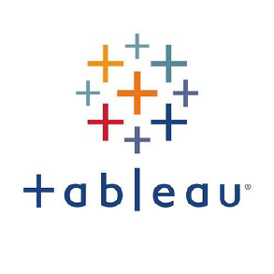




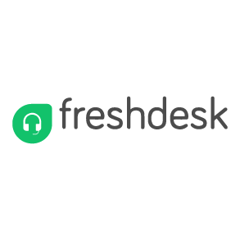
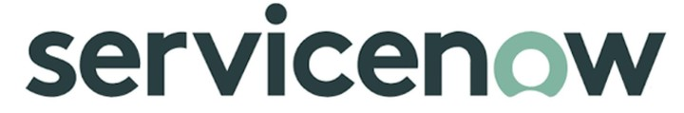


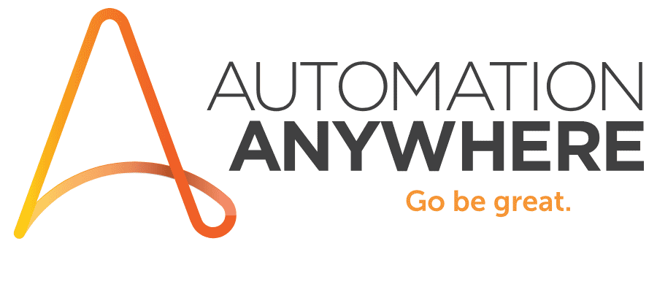




Enterprise ready pre-built integrations
Notes:
HRMS/HRIS
ATS
Payroll

Slide 10
Indicative Timeline | Cost | ROI - VoiceBOT
Estimated Cost
Indicative timeline
One time - 15k to 50k
Agent Seat cost $35 per Month
Call charges $0.05 to $0.15
Hosting charges :-$2500 per Month
8-12 Weeks
Project Benefit
Clip Level to ensure ROI
20-34% reduction in FTE.
Monthly Call volume < 25000

